Slide 1

Concrete Admixtures
Date: X/X/2021
Presented by
Selvamani. P
PDNS24-Nimr

Slide 2
Specifications & documents
Specification
SP-1282-Specification of Reinforced concrete-production and construction(version-6)-Part 2.4.3(Admixtures)
Reference documents:-
Inspection test plan
Concrete procedures
Mix design
Material approval sheet
Manufacturers data sheet:-
BASF-Rheo build 857
MCI-2005
Codes:-
ASTM C494 : Standard Specification for Chemical Admixtures for Concrete
ASTM G180 : Standard Test Method for Corrosion Inhibiting Admixtures
BS EN 480 : Admixtures for concrete, mortar and grout – Test methods

Slide 3
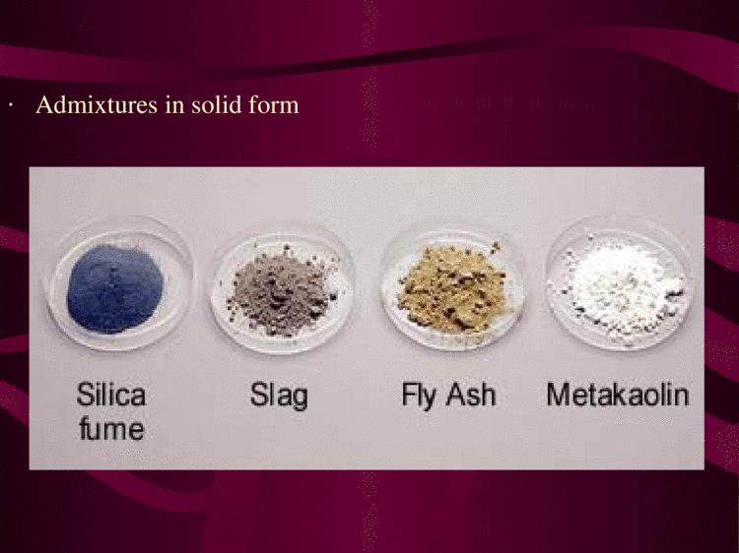
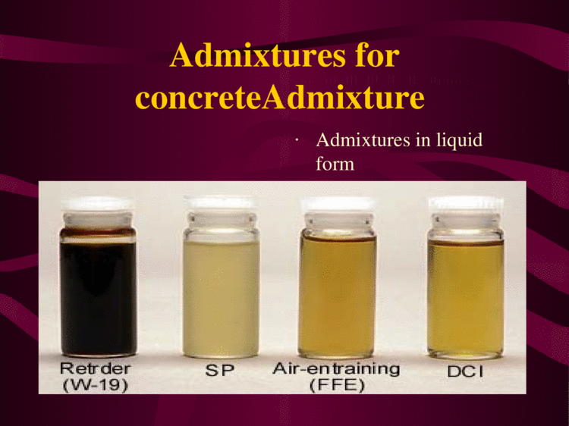
Admixtures
What is admixtures?
Admixtures are those ingredients in concrete other than Portland cement, Water and aggregates that are added to the mixture immediately before and during mixing.
Admixtures are used for to improve some characteristic properties of concrete
Concrete admixtures are natural or manufactured chemicals or additives added during concrete mixing to enhance specific properties of the fresh or hardened concrete, such as workability, durability, or early and final strength.

Slide 4
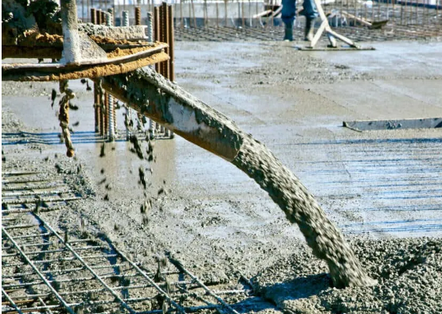
Admixtures
What are the major reasons for using admixtures?
Water reductions in mix
Mid –range water reducers
High- range water reducers(Super plasticizers)
High strength of the concrete
Corrosion protection
Set acceleration
Set retardation
Strength enhancement
Finish enhancement
Flowablity and workability
Protect against freeze thaw cycles and improve durability
Crack control (Shrinkage reduction)
Fly ash: Making concrete stronger, more durable and easier to work with
Silica Fume: Easy strength and reduced permeability
Produce a fluid backfill which flows easily and self leveling and compaction

Slide 5
Admixtures
How many types of groups of admixtures are there ACI?
In general, concrete admixtures can be divided into two major categories: Chemical admixtures and; Mineral admixtures.
Commonly used admixtures are,
Chemical Admixtures | Mineral Admixtures
Water reducing admixtures | Fly ash(FA)
Retarding admixtures | Silica fume(SF)
Accelerating admixtures | Ground granulated blast furnace slag(GGBS)
Air-entraining admixtures | Metakaolin(MK)
Corrosion Inhibitors | Rice husk ash(RHA)
Shrinkage reducers
Alkali-Silica reactivity inhibitors
Miscellaneous admixtures workability, bonding, damp proofing, grouting, gas-forming, coloring admixtures

Slide 6
Chemical admixtures
Chemical admixtures:-
ASTM C494/C494M, 2019 Edition, December 15, 2019 - Standard Specification for Chemical Admixtures for Concrete
Type A—Water-reducing admixtures,
Type B—Retarding admixtures,
Type C—Accelerating admixtures,
Type D—Water-reducing and retarding admixtures,
Type E—Water-reducing and accelerating admixtures,
Type F—Water-reducing, high range admixtures,
Type G—Water-reducing, high range, and retarding admixtures, and
Type S—Specific performance admixtures.

Slide 7
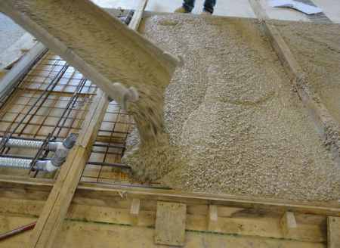
Admixtures uses
Water reducing admixture:-
Water reducing admixtures, the name itself defining that they are used to minimize the water demand in concrete mix.
In addition to increase in workability ,it also improve the strength of concrete, good bond between concrete and steel, prevents cracking,segregation,honeycombing,bleeding etc.
Water reducing admixtures are also called as plasticizers, mid-range plasticizers and super plasticizers.
Normal plasticizers reduces the water demand up to 10%,mid range plasticizers reduce the water demand up to 15% while super plasticizers reduce the water demand up to 30%.
They can be used to: (1) increase slump, (2) lower the water-cement ratio, or (3) reduce cement content.
In general, they provide the required slump with less water in the mix, and may provide higher strength concrete without increasing the amount of cement.
Calcium, sodium and ammonium lignosulphonates are commonly used plasticizers. Some of the new generation super plasticizers are acrylic polymer based, poly carboxylate, multicarbovylatethers etc.

Slide 8
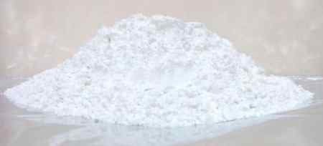
Retarding admixtures:-
Retarding admixtures slow down the rate of hydration of cement in its initial stage and increase the initial setting time of concrete. These are also called as retarders and used especially in high temperature zones where concrete set quickly.
Use of retarders is beneficial for:
Complex concrete placement or grouting
Special architectural surface finish
Compensating the accelerating effect of high temperature towards the initial set
Preventing cold joint formation in successive lifts.
Retarder can be formed by organic and inorganic material. The organic material consists of unrefined Ca, Na, NH₄, salts of lignosulfonic acids, hydroxycarboxylic acids, and carbohydrates(Sugar). The inorganic material consists of oxides of Pb and Zn, phosphates, magnesium salts, fluorates, and borates. Commonly used retarders are lignosulfonates acids and hydroxylated carboxylic (HC) acids,

Slide 9
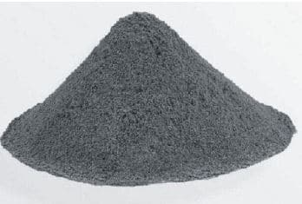
Admixtures uses
Accelerating admixtures:-
Accelerating admixtures are used to reduce the initial setting time of concrete. They speed up the process of initial stage of hardening of concrete hence they are also called as accelerators. These accelerators also improves the strength of concrete in it early stage by increasing the rate of hydration.
Earlier hardening of concrete is useful in several situations such as early removal of formwork, less period of curing, emergency repair works, for constructions in low temperature regions etc.
Some of the accelerating admixtures are triethenolamine, calcium format, silica fume, calcium chloride, finely divided silica gel etc. Calcium chloride is the cheap and commonly used accelerating admixture.

Slide 10
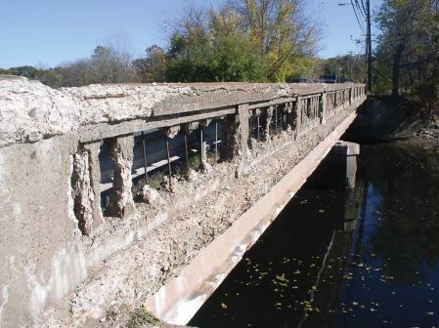
4. Air Entraining Concrete Admixture
Air entraining admixtures are one of the most important inventions in concrete technology. Their primary function is to increase the durability of concrete under freezing and thawing conditions.
When added to concrete mix, these admixtures will form millions of non-coalescing air bubbles throughout the mix and improves the properties of concrete.
Air entrainment in concrete will also improve the workability of concrete, prevents segregation and bleeding, lower the unit weight and modulus of elasticity of concrete, improves the chemical resistance of concrete and reduction of cement or sand or water content in concrete etc.
Most used air entrainment admixtures are vinsol resin, darex, Teepol, Cheecol etc. These admixtures are actually made of Natural wood resins, alkali salts, animal and vegetable fats and oils etc.

Slide 11
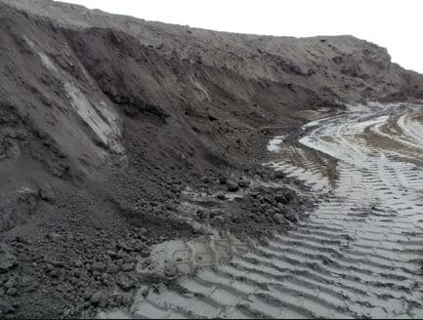
5. Pozzolanic Admixtures
Pozzolanic admixtures are used to prepare dense concrete mix which is bets suitable for water retaining structures like dams, reservoirs etc. They also reduce the heat of hydration and thermal shrinkage. Best pozzolanic materials in optimum quantity gives best results and prevents or reduces many risks such as alkali aggregate reaction, leaching, sulfate attack etc. Pozzolanic materials used as admixtures are either natural or artificial. Naturally occurring Pozzolanic materials are clay, shale, volcanic tuffs, pumicite, etc. and artificial pozzolans available are fly ash, silica fume, blast furnace slag, rice husk ash, surkhi etc.

Slide 12
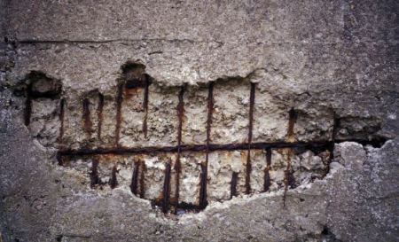
12. Corrosion Preventing Admixtures
Corrosion of steel in reinforced concrete structure is general and it is severe when the structure is exposed to saline water, industrial fumes, chlorides etc. To prevent or to slow down the process of corrosion preventing admixtures are used. Some of the corrosion preventing admixtures used in reinforced concrete are sodium benzoate, sodium nitrate, sodium nitrite etc.

Slide 13
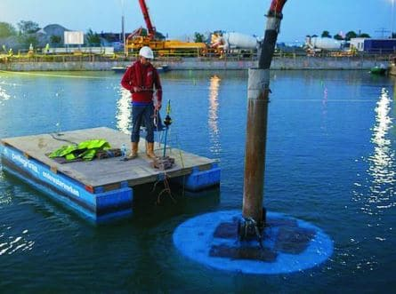
10. Anti-washout Admixtures
Anti-washout admixtures are used in concrete especially for under water concrete structure. It protect the concrete mix from being washed out under water pressure. It improves the cohesiveness of concrete. This type of admixtures are prepared from natural or synthetic rubbers, cellulose based thickeners etc.

Slide 14
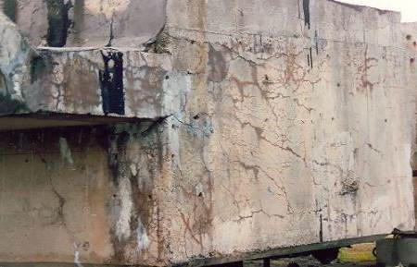
9. Alkali Aggregate Expansion Preventing Admixtures
Alkali aggregate expansion in concrete is happened by the reaction of alkali of cement with the silica present in the aggregates. It forms a gel like substance and cause volumetric expansion of concrete which may lead to cracking and disintegration. Use of pozzolanic admixtures will prevent the alkali-aggregate reaction and in some cases air-entraining admixtures are also useful. Generally used admixtures to reduce the risk of alkali aggregate reaction are aluminum powder and lithium salts.

Slide 15
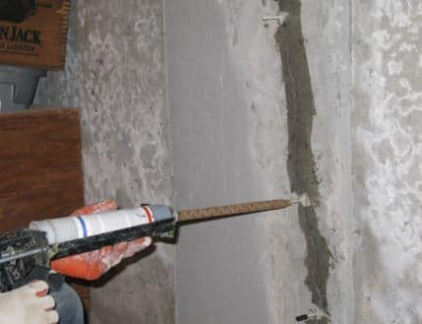
11. Grouting Admixtures
Grouting admixtures are added to grout materials to improve the grout properties according to the requirement of grout. Sometimes, there is a need of quick set grout and sometimes there is a need of slow set grout to spread into deep cracks or fissures. Hence, different admixtures are used as grout admixtures based on situation. Accelerators like calcium chloride, triethanolamine etc. are used as grout admixtures when the grout is to be set rapidly. Similarly retarders like mucic acid, gypsum etc. are used to slow down the setting time of grout. Gas forming admixtures like aluminum powder is added to grout material to counteract the settle of foundations.

Slide 16


Slide 17
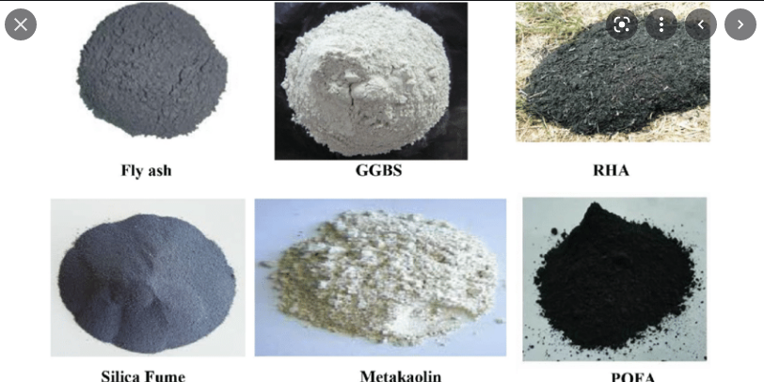
Mineral admixtures
Mineral admixtures
Mineral admixtures include any essentially insoluble material other than cement and aggregate, which is used as an ingredient for concrete, and is added to the batch immediately before or during mixing. Mineral admixtures include natural materials, processed natural materials, and artificial materials. Mineral admixtures include any essentialy insoluble material other than
Mineral admixtures (fly ash, silica fume (SF), and slags) are usually added to concrete in larger amounts to enhance the workability of fresh concrete; to improve resistance of concrete to thermal cracking, alkali-aggregate expansion, and sulfate attack; and to enable a reduction in cement content

Slide 18
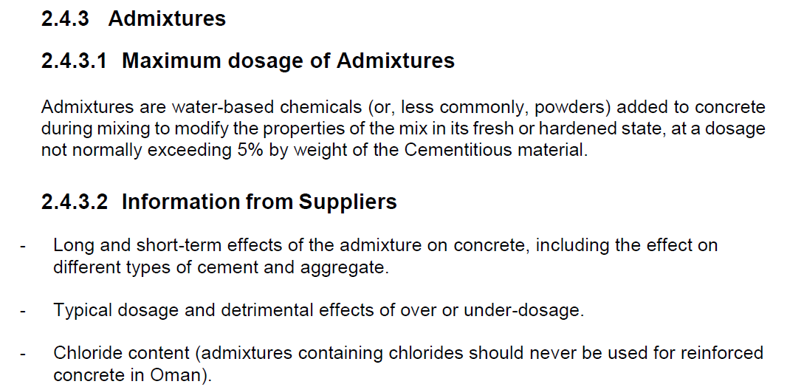
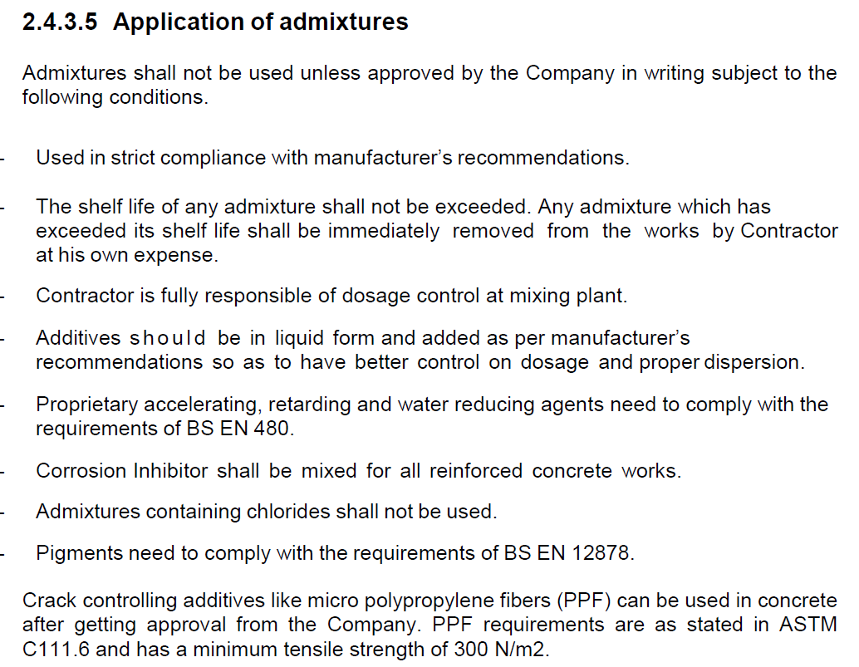
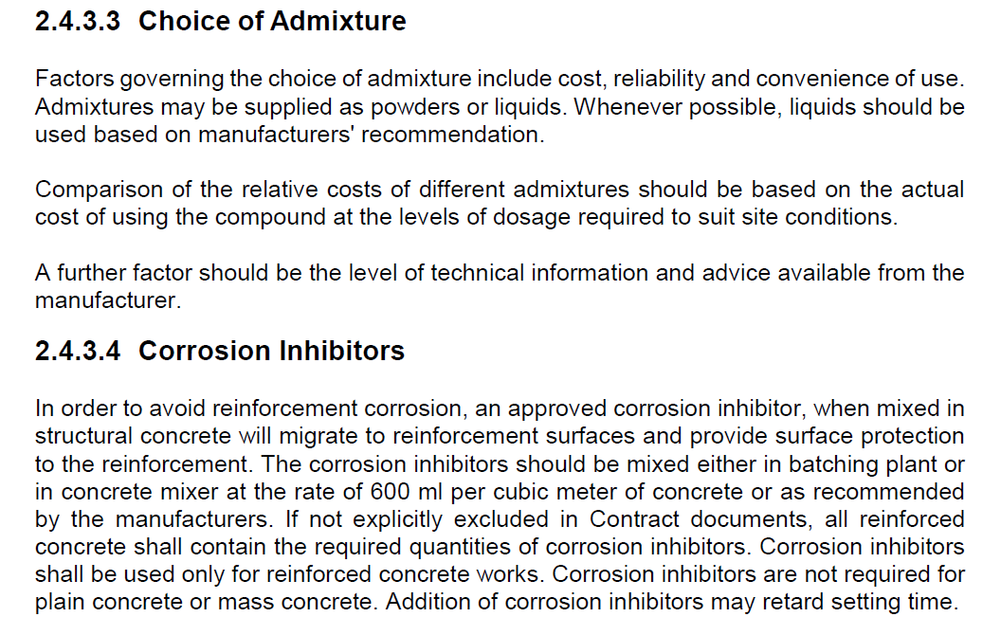
SP-1282

Slide 19
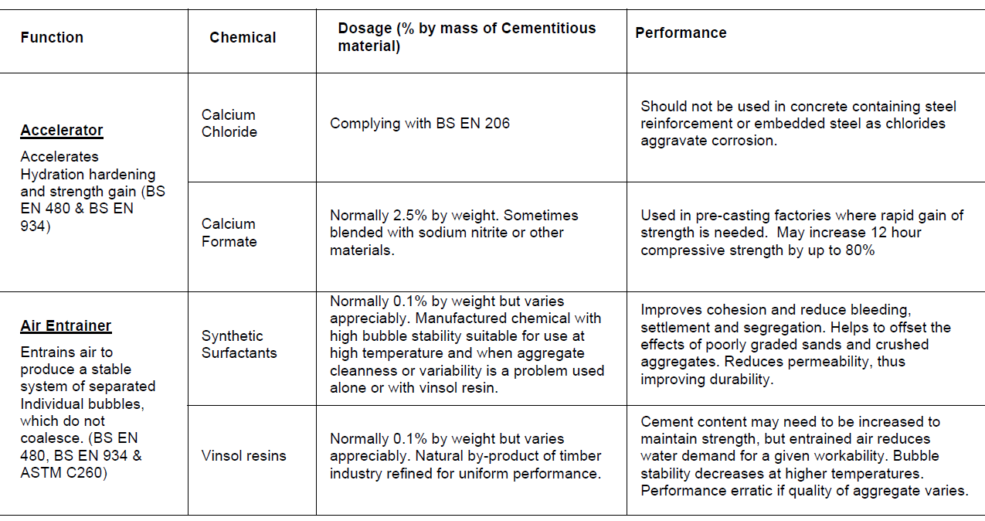
Admixtures, Dosage and Performance

Slide 20
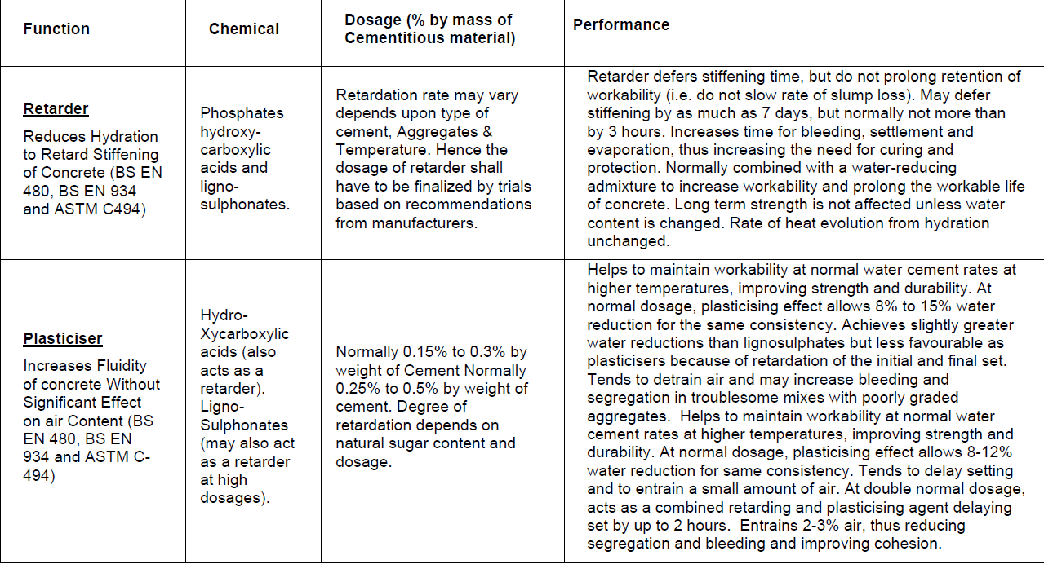
Admixtures, Dosage and Performance

Slide 21
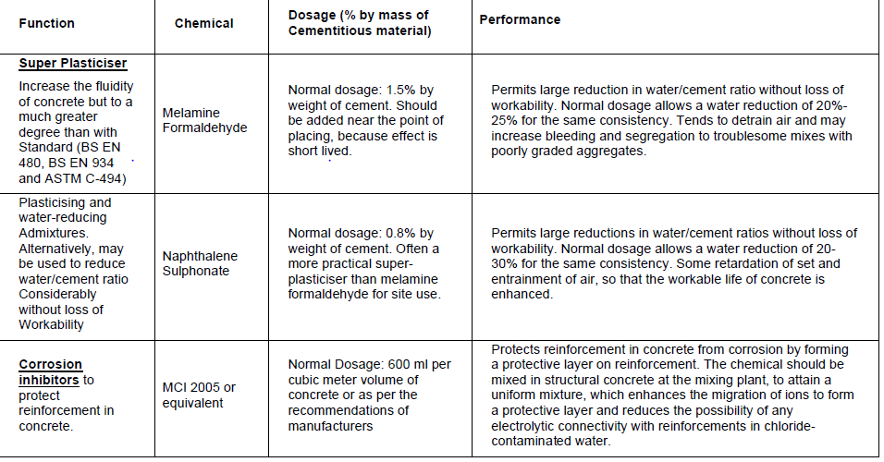
Admixtures, Dosage and Performance

Slide 22
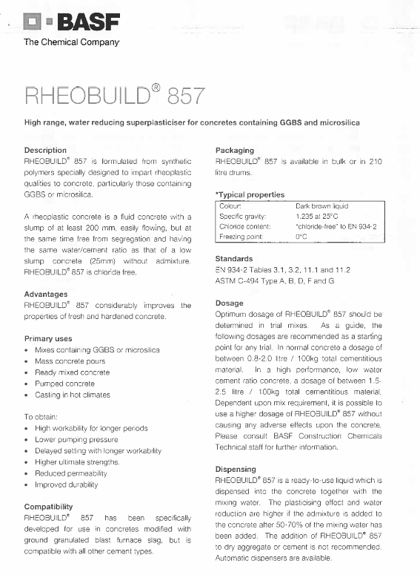
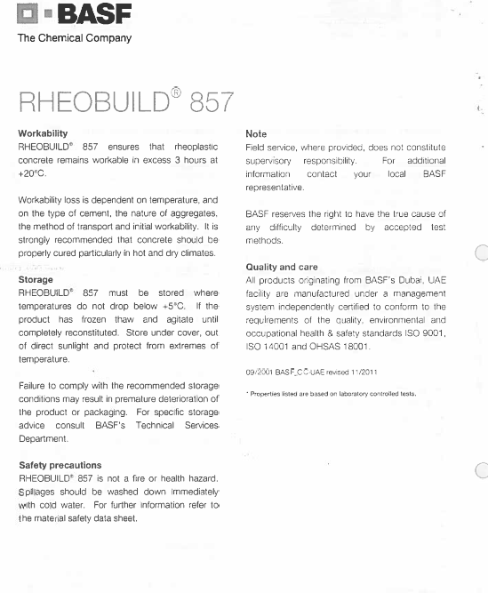
RHEOBUILD 857 DATA SHEET

Slide 23
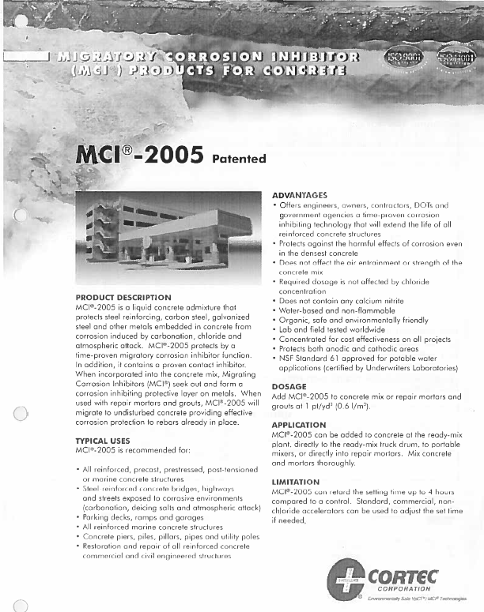
MCI-2005 data sheet

Slide 24

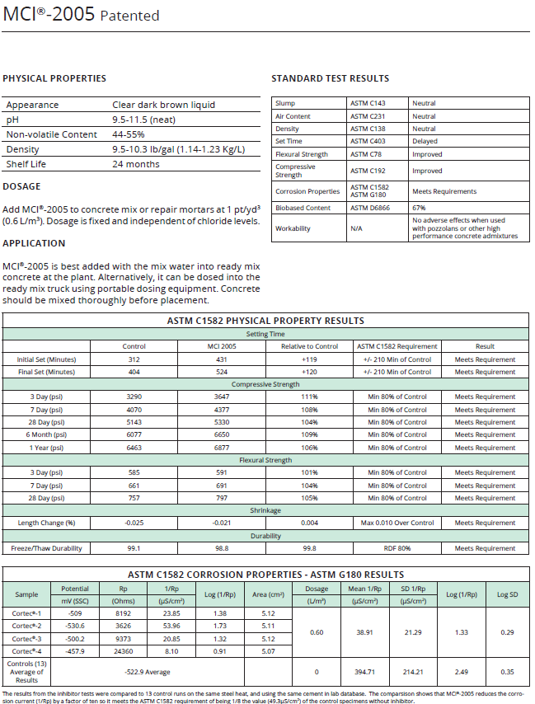
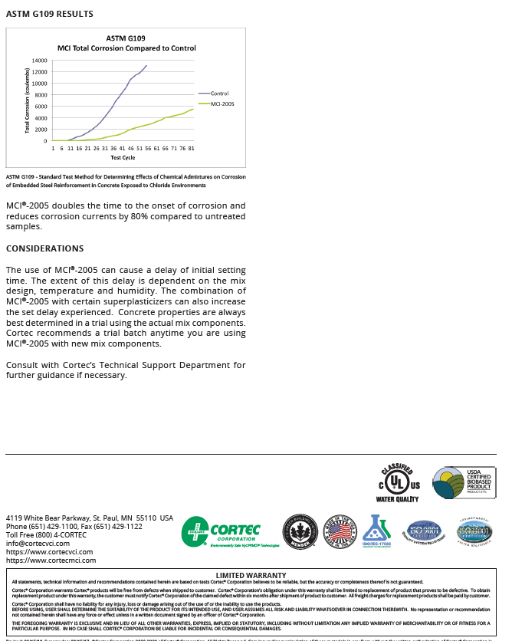
MCI-2005 data sheet

Slide 25
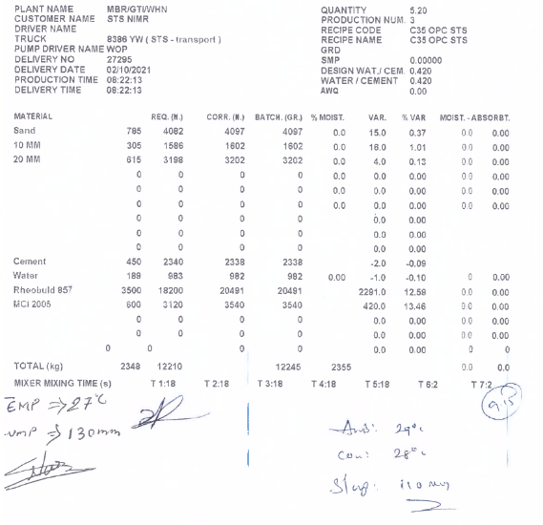
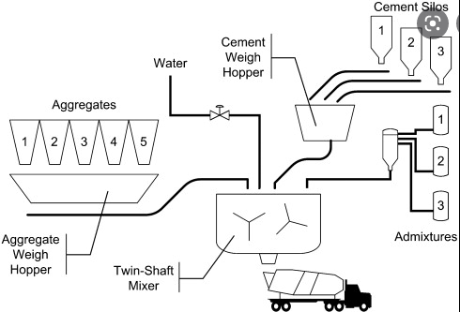
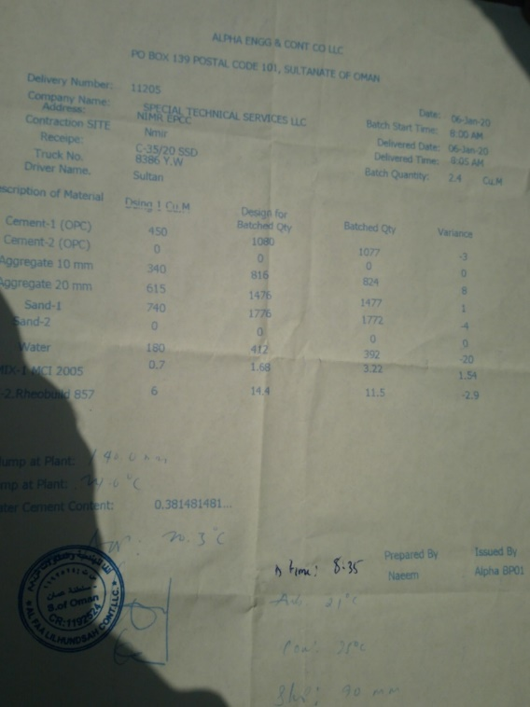
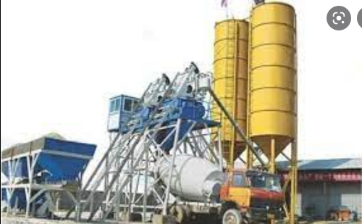
Concrete delivery ticket

Slide 26
Thank you

